Slide 1

Basic GPT-2 Text Generation
TEXT GENERATION WITH HUGGING FACE
Notes:
Welcome to our lesson on using Hugging Face Transformer Models for Basic GPT-2 Text Generation - a lesson that will help you learn how to use text generation models, as well as create engaging interactive fiction and digital storytelling experiences.

Slide 2
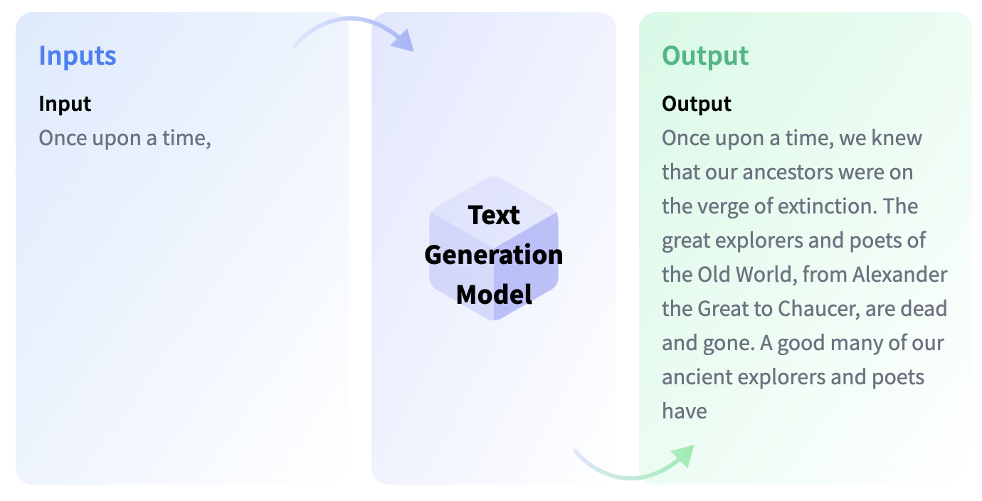
The task of generating new text given another text.
Summarise, translate, fill-in an incomplete text
Text generation strategies with prompts or story starters.
Notes:
New text can be generated using a Text Generation Model. This involves an input-output flow, where an initial text input, such as a story starter, is provided to the model. For example, starting with "Once upon a time," the model continues the narrative, producing a coherent output. Is it creative and engaging?
Well, in this instance, the output expands on the initial prompt, weaving a tale about ancient explorers and poets. The generated text reads about bold human ancestors, who faced extinction… but the story is only just beginning.
Hugging Face Transformer models have the capability to
Generate new text based on a given input.
Summarize, translate, or fill in incomplete texts.
Employ text generation strategies using various prompts or story starters.

Slide 3
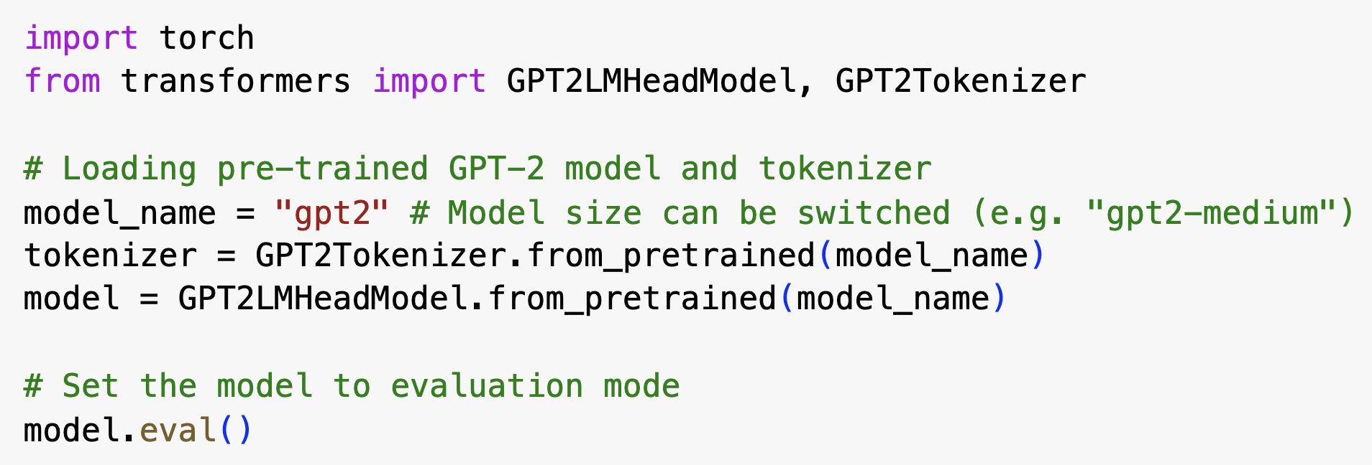
Notes:
Before you plough ahead into text generation with GPT-2, you need to set up your Python environment and install the required libraries.
You'll need torch and transformers. You can install these using pip if you haven't already:
You'll need to choose a specific version of GPT-2. For basic purposes, "gpt2" is the standard model, but you can also opt for larger versions like "gpt2-medium", "gpt2-large", or "gpt2-xl" for potentially better performance at the cost of increased computational resources.
Setting the model to evaluation mode is crucial for making predictions as it disables training-specific behaviors like dropout:
Now that the model is loaded and set to evaluation mode, you can use it to generate text based on prompts you provide.

Slide 4
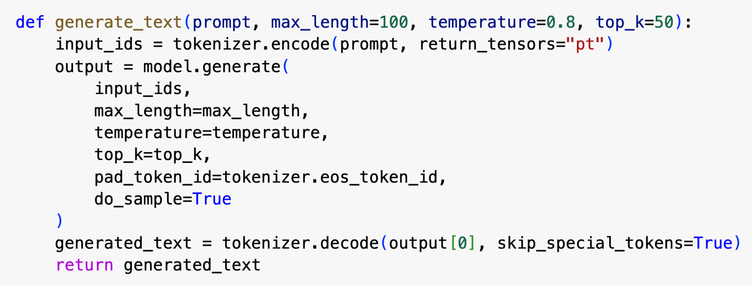
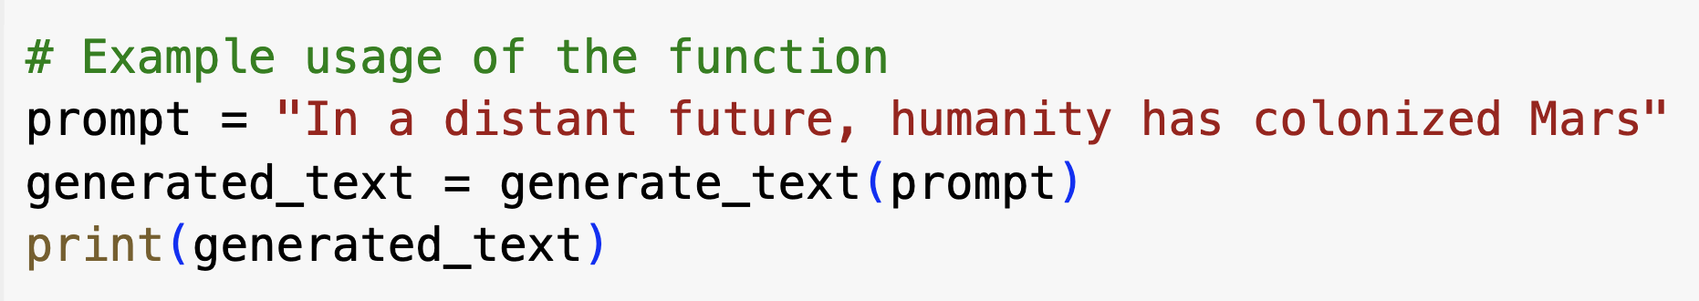
Notes:
Let’s define a function to generate text based on a given prompt.
Once you have the tokenizer and the model properly set up and initialized as we have already done, simply call the function and away you go.
Here is an example of calling this generate_text function. I hope you’ll agree - straightforward and easy.
Now there are parameters that can be adjusted for more control, such as Max Length, Temperature, and Top-k Sampling, which you can see in this example code. But we will leave this for our next lesson.

Slide 5
In a distant future, humanity has colonized Mars…
...which is the only place in the universe that a human has ever been. Mars is not a world with many moons.
The Earth is now inhabited by a group of intelligent machines. These machines have discovered a new life and are creating a new civilization. In one of these machines, a woman named Clara, is born. She is one of the first humans ever to be born and can be considered a human.
The robots were...
Creative Writing
With text generation, an author could:
overcome writer’s block
brainstorm new ideas and stories
develop plotlines
craft complete narratives.
Notes:
Text-generative AI can help content writers, such as fiction authors, to overcome writer’s block. It might serve as a creative springboard or offer different perspectives. Authors and content creators could leverage this technology to ensure unique and interesting plots, and ensure that the story being told remains coherent and complete.
Here we can see the generated text, which has reached the max_length at “The robots were…” Not bad. Certainly coherent and engaging. A human born to robots - would you have thought of that? and would you keep reading?

Slide 6
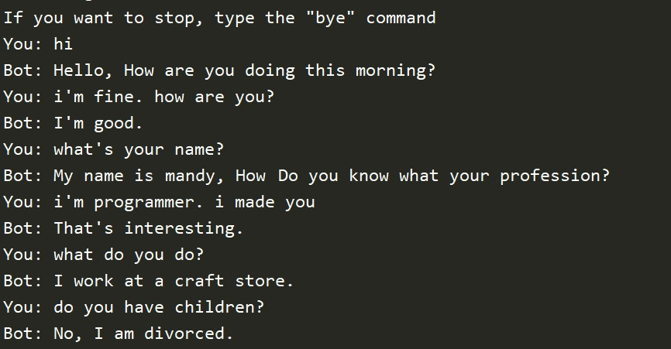
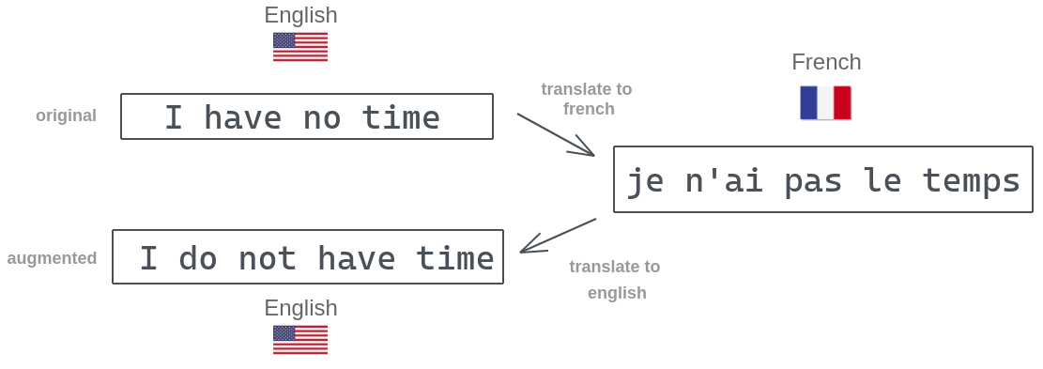
Chatbots and Virtual Assistants
more natural
increased relevance
awareness of context
improved UI experience
Data Augmentation
create more text data
enhance ML models
unlock more scenarios
Notes:
Chatbots and Virtual Assistants GPT-2 improves chatbots and virtual assistants by making their responses more natural and relevant. improving their ability to generate natural, context-aware responses. This capability significantly improves the overall user interaction experience.
GPT-2 can be used in Data Augmentation to create extra text data, e.g. enhancing machine learning models when there's not enough original data. This supplementary text data is crucial for boosting machine-learning model performance, especially in scenarios with scarce training data. A common NLP example, as given here, would be back-translation to generate textual data with different words while preserving the context.

Slide 7
Let’s practise!
TEXT GENERATION WITH HUGGING FACE
Notes:
Now it's your turn! Use the provided code to practise importing an ‘off the shelf’ GPT-2 model and generating your own text.

